Slide 1
NSSLHA September Meeting
Get excited! It’s going to be a great year.

Slide 2
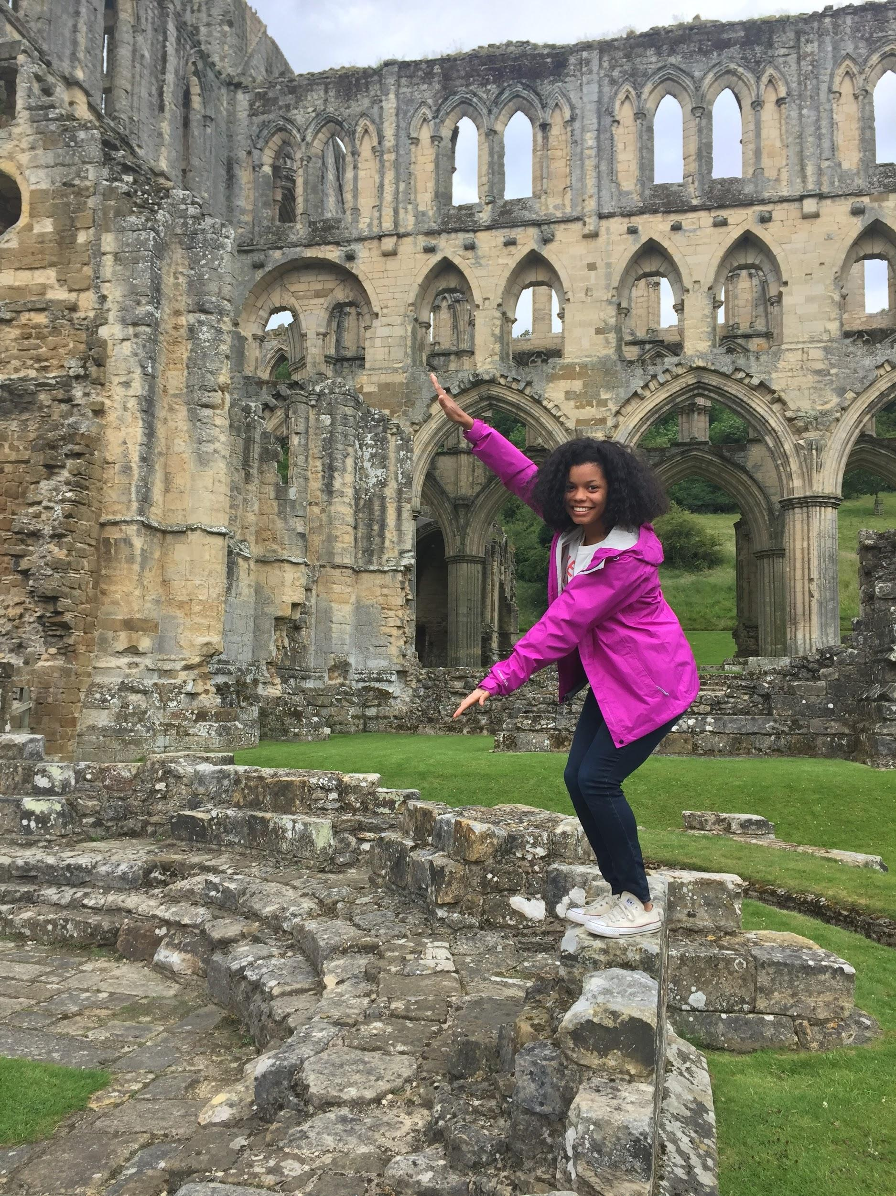
President: Morgan Billinger
President: Morgan Billinger
Minor: Linguistics
Status: Senior (Speechie)
Fun Fact: I studied abroad this past summer in London, England.

Slide 3
President’s Notes
Study Abroad? For OUR major???
http://www.international.fsu.edu/Types/College/England/ScienceandDisorders/CommunicationSD.aspx

Slide 4
S.T.E.P Mentoring Program
What is S.T.E.P?
An annual ASHA sponsored mentoring program that provides undergraduate students with a one to one connection to an experienced ASHA member. Some of the benefits of participating in this program include “getting guidance, resources, and opportunities especially designed for you, a mentor relationship that can last for a lifetime, and finally networking with over 1,500 mentees and mentors in the S.T.E.P. Community!”
Enrollment is open through September 15!
You must have an ASHA membership in order to apply.
http://www.asha.org/students/mentoring/step/?utm_source=asha&utm_medium=email&utm_campaign=mrrstep082415

Slide 5
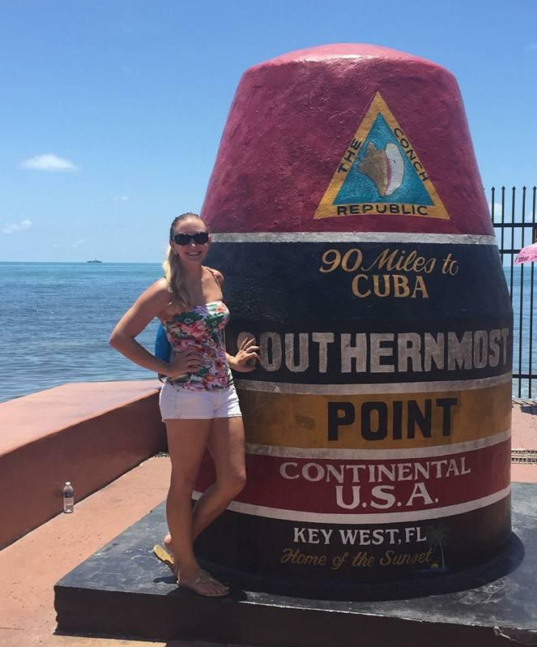
Vice President: Emily King
Major: CSD
Minors: Communication Studies, Linguistic Studies
Fun Fact: I love to travel, and went on 10 small road trips with friends this summer. I even tried deep sea fishing

Slide 6
Meetings
Meetings are always Tuesdays in CSE Room E222
Today, 9/8 - Meet and Greet
10/13 - Dr. Logan (GRE + Grad Prep)
11/10 - Guest Speaker TBA
12/8 - Guest Speaker TBA

Slide 7
Secretary: Tyler Dwyer
Year: Senior (Speech)
Minor: Disabilities in Society
Fun fact: I am the oldest of 7. There is a bigger age gap between me and my youngest brother (20 yrs) than between my mom and I. (19 yrs)

Slide 8
Points for Active Membership
Fall Active Membership
3 meetings
3 services
2 fundraisers
2 socials
Spring Active Membership
3 meetings
3 services
  1 is volunteering at Symposium
  1 is volunteering at Stride
2 fundraisers
2 socials
1 Attend Symposium
1 Attend Stride Against Silence

Slide 9
The Bare Minimum to be “active” (as in... go to more if you can)
Email points to → tdwyer@ufl.edu
*Points are required to be active, but the goal is for you to go to things because you WANT to, not because you HAVE to. Be involved, not just “active.” (please)
**You get out of NSSLHA what you put into NSSLHA. Cliche but true
*** Seniors: If you are an active member for your full senior year,you will be eligible to receive cords for graduation. Everyone else: You will get something cool yet to be determined.

Slide 10
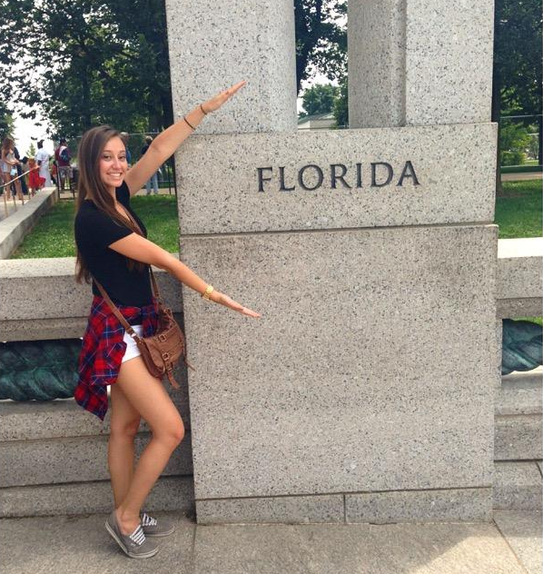
Treasurer: Brittany Larson
Year: Senior (Audiology!)
Minor: Spanish
Fun Fact: I love to dance
and I’m on a dance team
at UF. I also paint and
draw in my (nonexistent)
spare time.

Slide 11
Upcoming Fundraisers
*Dates are tentative*
Yogurt and Yoga Social/Fundraiser
- Friday, September 25th after yoga
Piesano’s Pizza
- October
Tijuana Flats
- Tuesday, November 10th after meeting
Bento Cafe
- First week of December

Slide 12
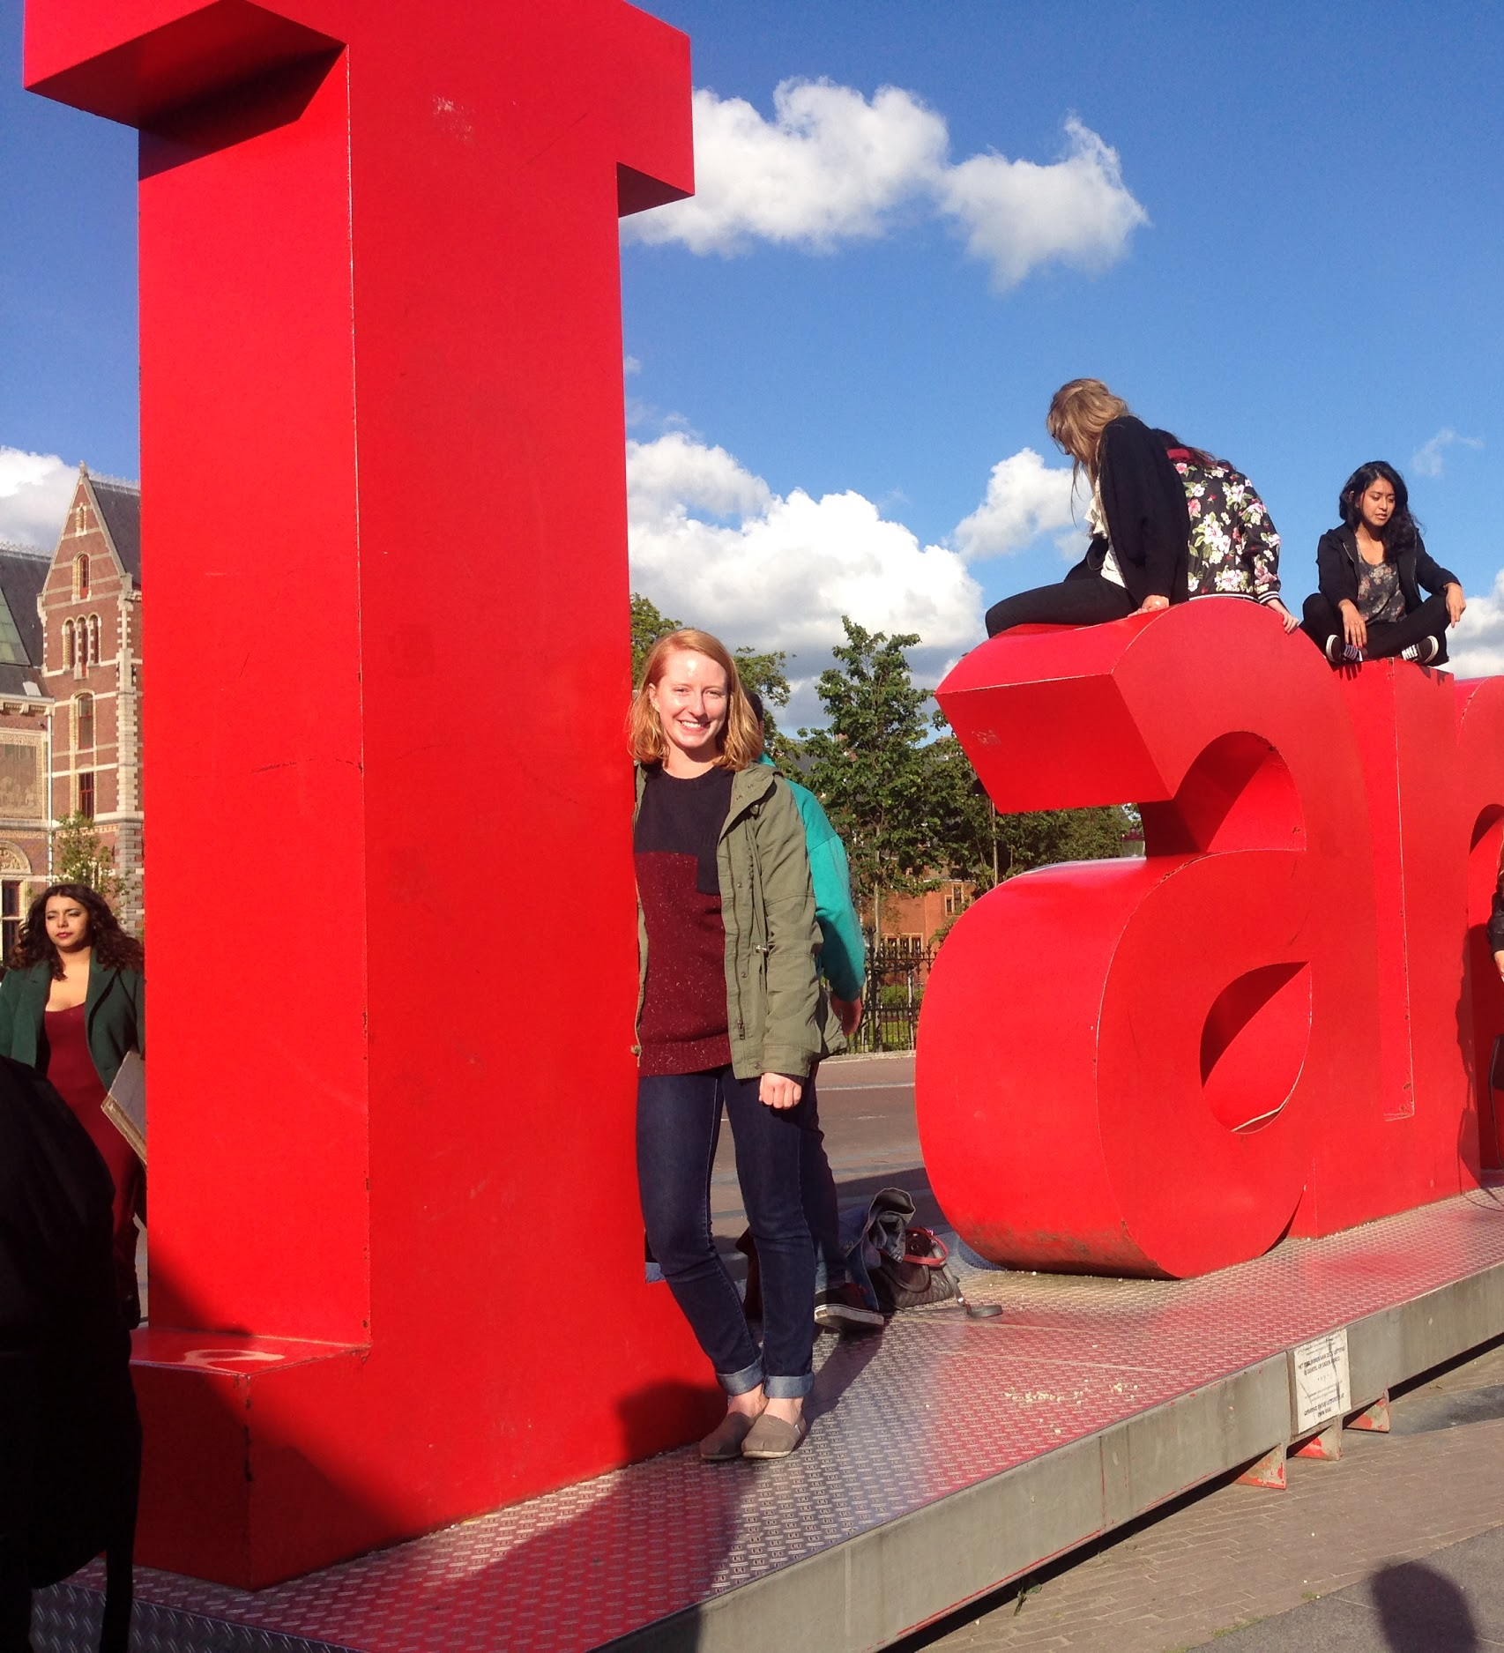
Service Chair: Lily Parrish
Year: Junior (Speech)
Minor: Spanish
Fun Fact: I am currently sitting on my couch because I have mono.

Slide 13
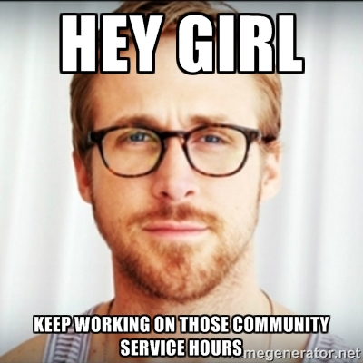
Service Opportunities
Einstein School
  Christine Aurelio: msaurelio@emschool.org
Friends Across the Ages (can only accept 1-2)
  Allison Blay: allison.blay@acrosstheages.org
Sidney Lanier School
  contact me at nsslhagators@gmail.com if interested
Al’z Place
  (352) 375-3000
TOP Soccer- volunteering as a group on October 16th
  http://www.gainesvillesoccer.org/topsoccer/
IMPACT Autism
  impact.autism@gmail.com
Walk to End Alz NSSLHA team- October 10th
  http://act.alz.org/site/TR/Walk/General?pg=entry&fr_id=7386
Trying to coordinate a group for the Craniofacial weekend at Camp Boggy Creek in the spring. The date isn’t posted as of right now but I will keep you all updated.
Notes:
Your service points don’t have to come off of something on this list, these organizations are just ideas. This year I am working to coordinate a lot more group service projects so that we can give back to the community together!
Einstein School- A school for students with reading difficulties. There are several SLPs on staff that you may be able to work with. The woman said that they also hire students with CSD bachelor’s degrees to work for two years before getting their masters. If that is something you might be interested in doing, I would suggest trying to volunteer there.
Friends Across the Ages: A general nursing home, get experience working with that population. Can only take a few volunteers at this time. I will be trying to arrange a group service activity with them too.
Sidney Lanier- I am working with the PE teacher there. We can coordinate individual volunteering but I am also trying to arrange a group volunteer activity there as well.
Al’z Place- A daily care program for seniors with Alzheimer’s. You can call this number to find out more information if you are interested. I will be trying to arrange a group service project.
TOP Soccer- Soccer league for children with disabilities. Friday nights during the fall, the first one is this friday at 6 pm, follow the link in the powerpoint to register as a buddy and find out more information. We are coming out as a group on 10/16 to help out!
IMPACT is a service club on campus that focuses on individuals with autism, contact that email for more information- lots of service opportunities here!
Walk to End Alz- Benefit walk in Westside Park in Gainesville.
Keep an eye out on the Facebook page for more opportunities as they come!

Slide 14
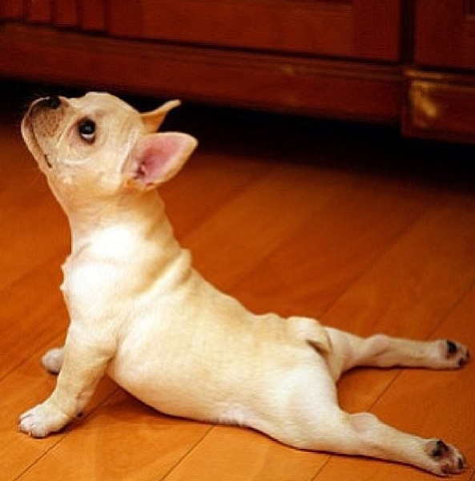
Social Chair: Karla Chacon
Year: Senior (limbo)
Minor: Linguistics
Fun Fact:I’m a yoga instructor and am currently training for my first half marathon :)

Slide 15

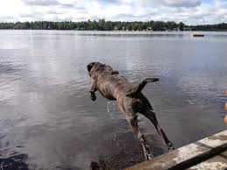
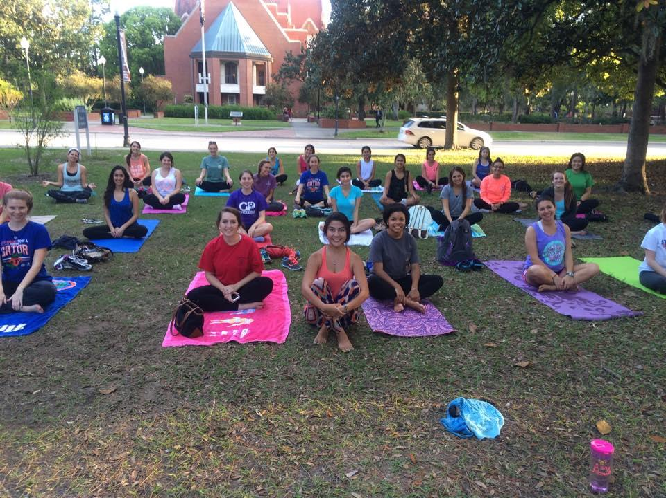
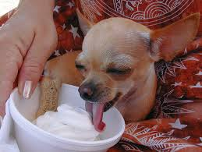
September Socials!
9/13 (Sunday): 11 am
Picnic @ Lake Wauburg
9/25 (Friday): 6 pm
Yogurt and Yoga @ Plaza of the Americas/ Mochi on University

Slide 16
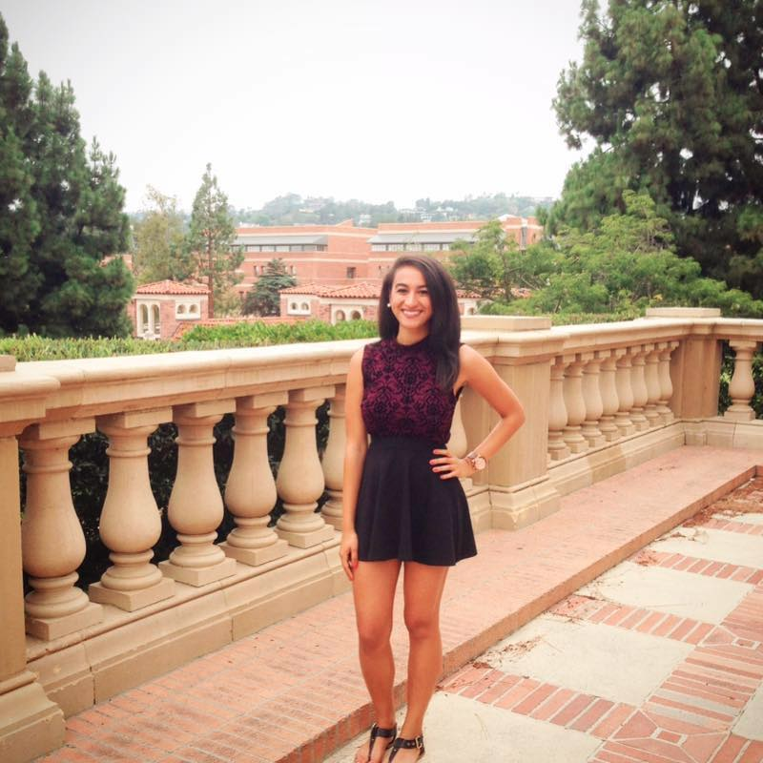
Advertising Chair: Soraya Sayegh
Year: Junior (Speech)
Minor: Disabilities in Society
Fun Facts: I was born in Montreal, Canada. I’m trilingual and love to go backpacking and ATV riding.

Slide 17

NSSLHA’s Upcoming Merchandise!
-NSSLHA T-Shirts coming soon!!
This year we will be introducing a Voting System to choose the design for the official 2015-2016 NSSLHA T-shirt!
-New NSSLHA items added to our merchandise list for sale
•NSSLHA Tank Tops
•NSSLHA Bumper/Laptop Stickers
•NSSLHA Pins
-End of the Semester Raffle
Each meeting and socials, we will be selling raffle tickets
Last meeting of the semester, one lucky member will win a NSSLHA gift basket
All proceeds go to the NSSLHA club budget so please support !!

Slide 18



Slide 19
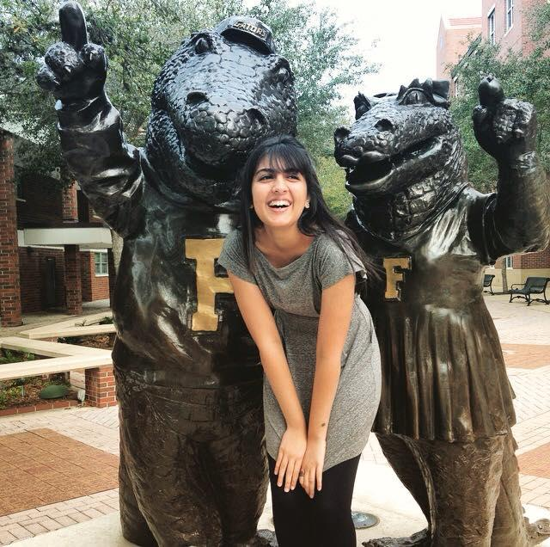
Public Relations Chair: Zoreen Syed
Year: Senior (Speech)
Minor: Family, Youth and Community Sciences
Fun Fact: Back in High School, I once auditioned for MTV’s Made. I wanted to be ‘Made’ into a Breakdancer!

Slide 20
Stay Up-to-Date With Us!
#1 source - http://nsslhaufl.weebly.com/
‘Like’ us on Facebook! - Nsslha UF
  Join our group - NSSLHA at UF
Follow us on Instagram @nsslhagators

Slide 21
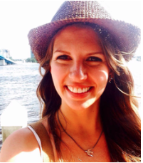
G. Paul Moore Symposium Chair: Lena Wedeen
Year: Senior,
SLP
Interested
in pediatrics
Fun Fact! I’ve been
snowmobiling in Jacksonhole, WY

Slide 22
G. Paul Moore Symposium Co-Chair: Angela Andersen
Year: Junior (Speech)
Minor: Disabilities in
Society
Fun Fact: I came face-
to-face with a shark
on my cruise this summer.

Slide 23
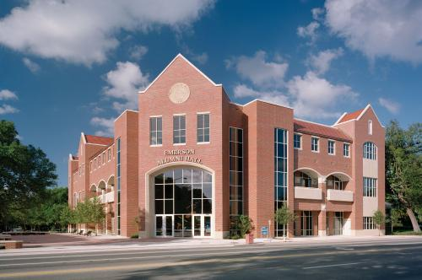
38th Annual G. Paul Moore Symposium!
February 2nd and 3rd, 2016
AuD Speaker: Dr. David Zapala
SLP Speaker: Dr. Jana Oetting

Slide 24
Stride Against Silence Chair: Sarah Falls
Year: Senior (Speech)
Minor: Educational Studies
Fun Fact: I studied abroad
in Florence, Italy this summer!
I was able to travel to France,
Germany, and Austria.

Slide 25
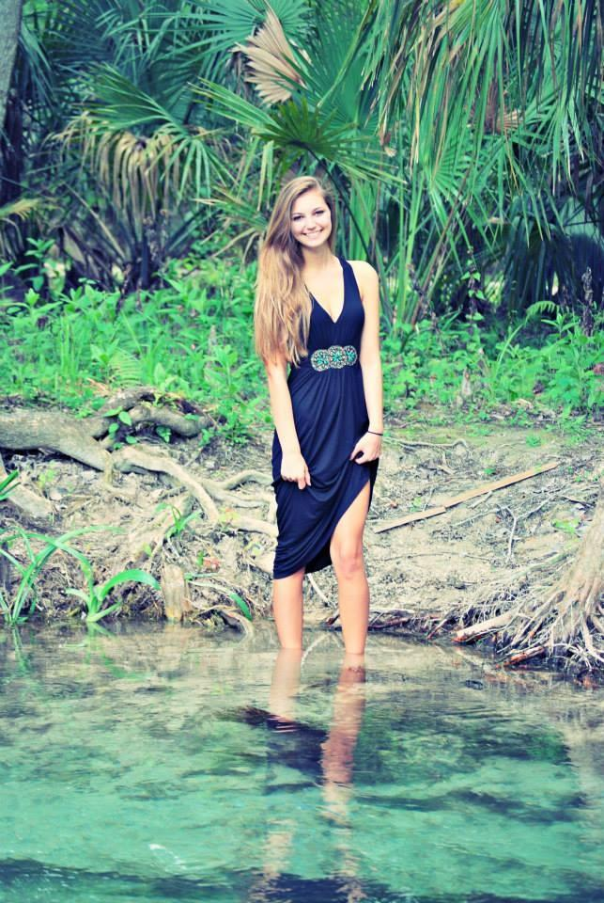
Stride Against Silence Co-Chair: Brittany Schmidt
Year: Junior (Speech)
Minors: Linguistics and Business Administration
Fun Fact: I’m a concert junkie; I’m going to (at least) three this semester: Alt-J, Walk the Moon, and Big Ticket Fest.

Slide 26
Stride Against Silence 5K - 3/12/16
An annual 5K run/walk (spring semester) that benefits the Cochlear Implant Department at the UF Health Speech and Hearing Center
More information on committees and the 5K to come

Slide 27
Go Gators! Go NSSLHA!
Please feel free to ask your officers questions if you have any, and get to know who is interested in the same things as you are! You can reach us through nsslhagators@gmail.com or through FB as well.
Let’s have a great year!

