Slide 1
October NSSLHA Meeting
October 13, 2015

Slide 2
President: Morgan Billinger
ASL 101 Workshop : Co-sponsored event with Signing Gators that will be taking place the first week of November (tentatively). The event will include an introduction to American Sign Language and a chance to communicate with other fluent ASL speakers, guest speakers from both SLP- and AuD fields, and not to mention food!
We are in need of volunteers who would be interested in working alongside Karla and Soraya, for the Faculty/ Student Meet and Greet ( November 20th)
Thank you all for continued support and dedication to this organization.

Slide 3
Vice President: Emily King
November Guest Speakers: Tuesday, 11/10/15, CSE E222 6:15 PM
Mrs. Christie Williams, SLP and an audiologist TBA
November (first ever :D) Workshop: Tuesday, 11/17/15 CSE E222 6:15 PM
Dr. Melissa Johnson of the Honors Program Advisory Faculty will be presenting a resume workshop, where we will practice our skills in professionalism. Feel free to bring your resumes to revise and questions to bring to the table.

Slide 4
Secretary: Tyler Dwyer
Email me with any service points as you get them. No need to wait to get all 3. I would rather you know exactly where you stand with all your points.
Please be sure to keep track of your points and email me should any discrepancies arise.
Just a reminder: Please don’t wait til December to get all your points.
  You have other things to worry about at the end of the semester (finals, grad apps, graduating :( ) Knock those out, so you don’t have to stress later.
Points spreadsheet: https://docs.google.com/spreadsheets/d/1tATdhJJA56zYrPLgX5-kbsIRZsCtFTW4itvDj39_Hx0/edit?pli=1#gid=1673436481

Slide 5
Treasurer: Brittany Larson
Mochi Fundraiser - Great Turnout!!!
OCTOBER 27th: Piesano’s Pizza Fundraiser
- Corner of 13th and University (part of the Holiday Inn)
NOVEMBER 10th: Tijuana Flats Fundraiser (after meeting)
- University Ave in Midtown
DECEMBER: Bento Fundraiser

Slide 6
Service Opportunities
***Email tdwyer@ufl.edu with photographic evidence to receive points***
10/16: THIS FRIDAY→ TOP Soccer
  Arrive at Jonesville Park by 5:30 pm, ends at 8:00. Wear athletic clothes.
11/14: 2015 First Coast Walk for Apraxia→http://casana.apraxia-kids.org/site/TR?fr_id=1360&pg=entry
  Register under the team “UF NSSLHA.” We will be arranging a carpool.
11/20: CSD Meet & Greet→ need volunteers at the event.
  You will receive a service point for volunteering at the event, not for simply attending the event.
Einstein School→Christine Aurelio: msaurelio@emschool.org
Friends Across the Ages→Allison Blay: allison.blay@acrosstheages.org
Sidney Lanier School→Winston Church: churchwb@gm.sbac.edu
Al’z Place→(352) 375-3000
IMPACT Autism→impact.autism@gmail.com
Spring Craniofacial weekend at Camp Boggy Creek-stay tuned!

Slide 7
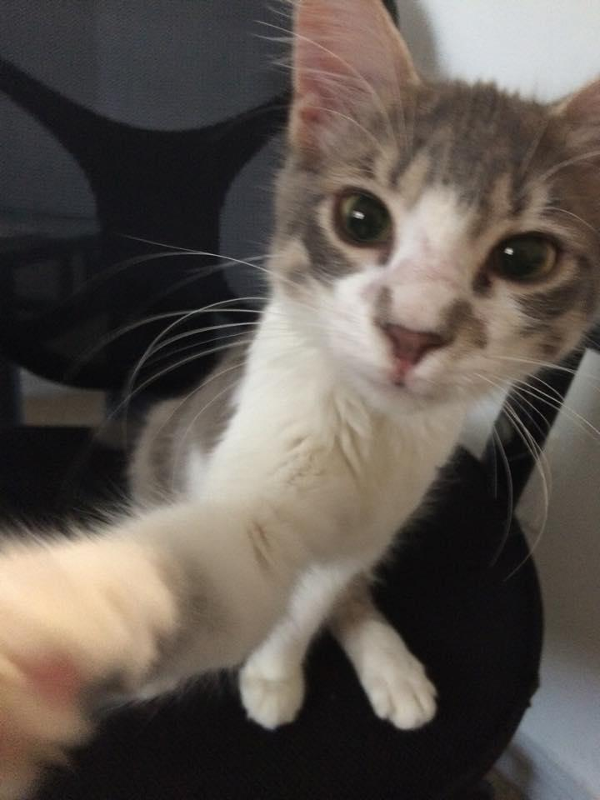
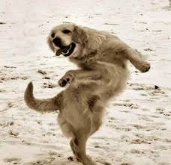
Social Chair: Karla Chacon
*mentor/mentee program is starting off!
Thank you to everyone who came out to Lake Wauburg and/or Yogurt and Yoga! :)
Friday 10/23 at 6 pm: Newberry Haunted Corn Maze. Bring $10 :)
*Rides will be arranged via GoogleDoc
Thursday 10/29 7-9 pm: Thriller Night (Spooky Zumba) $Free.99
*Sign up 25 hours before on UF RecSports website and wear your costumes! :)

Slide 8
could be us but you playin’

Slide 9

Advertising Chair: Soraya Sayegh
UPDATE ON SPEECH LANGUAGE PATHOLOGY GEAR!
*ORDERS ARE STILL IN THE PROCESS OF BEING SHIPPED TO GNSSLHA
*ONCE THEY ARRIVE, WE WILL DISTRIBUTE THEM ASAP AT THE NEXT NSSLHA GATHERING
*ALSO, NEXT MEETING WE WILL BE HAVING A VOTING SYSTEM TO CHOOSE OUR OFFICIAL 2015-2016 NSSLHA CLUB T-SHIRT DESIGN!

Slide 10
Public Relations Chair: Zoreen Syed
Stay up-to-date with our official site
  http://nsslhaufl.weebly.com/
    Calendar, documents, sign-ups, powerpoint presentations
‘Like’ us on Facebook: NSSLHA UF
  https://www.facebook.com/NsslhaUF
    Subscribe to our events!
Join our Facebook Group: NSSLHA @ UF
  https://www.facebook.com/groups/189375507800736/
    General questions (i.e classes, points)
Follow us on Instagram: @NSSLHAGators
  Graduate spotlight
  Active Member of the Month

Slide 11

Symposium Chairs: Lena Wedeen & Angela Andersen
“Like” the G. Paul Moore Symposium Facebook page!
https://www.facebook.com/G-Paul-Moore-Symposium-1616187881994810/timeline/
Mission Statement:
  To honor the memory of Professor G. Paul Moore by connecting students and practitioners to state of the art, evidence-based knowledge in Speech-Language Pathology and Audiology.
Congratulations to the winner of our logo contest- Holly Mulhern

Slide 12
Guest Speaker for today’s meeting:
Dr. Kenneth Logan, Ph.D., CCC-SLP
Please give a warm welcome to Dr. Logan, the undergraduate and graduate CSD program Director!

