Slide 1
Dr. G. Paul Moore Renowned Professor and leader in Voice Science and Rehabilitation
November 2, 1907- Jan. 17, 2008

Slide 2
Quick Facts About Dr. Moore
He lived to be 100 years old
Known for his development of high speed photography of the human vocal folds
Well published and authored many books, journal articles, films, and videos
He was the first person to receive a Ph.D. from Northwestern’s School of Speech
He was a beloved faculty member at both Northwestern and at the University of Florida

Slide 3
Educational Background
Received a bachelor of art degree from West Virginia University in 1929
Received a master’s degree in voice pathology and laryngeal function from Northwestern University in 1930
Received his P.h.D. in voice pathology and laryngeal function from Northwestern University in 1936
Received an honorary Doctor of Science degree from West Virginia University in 1974

Slide 4
Professional Positions/Accomplishments
Dr. Moore was a faculty member at Northwestern University for 32 years. He served as the Director of the Voice Clinic, and Director of the Voice Research Laboratory.
Professor and Chair of the Communication, Sciences, and Disorders Department at the University of Florida from 1962-1980
Though he retired in 1980, he remained active in the department until 1998.
Director of the communications sciences laboratory, distinguished service professor, and distinguished service professor emeritus at the University of Florida
ASHA president (1961)
ASHA Fellow and Received ASHA Honors in 1966
G. Paul Moore Symposium named in his honor
Honored by the Voice Foundation at their annual Symposium on Care of the Professional Voice with The G. Paul Moore Lecture.

Slide 5
Research
Major area of emphasis was in high-speed films of the larynx
He worked on fiber optic devices to better view the larynx
He is considered a pioneer in video stroboscopy/ fluoroscopy
He was the first person to suggest multidisciplinary collaboration between speech-language pathology and otolaryngology
He helped invent the Language Master - an old system that some people still use in therapy. It consisted of cards, often printed with stimuli, that have a magnetic strip at the bottom. The card gets put through a player and it plays back (sort of like a tape loop). It is great for client feedback.

Slide 6
The Moore Family
Dr. G. Paul Moore has a daughter and son
Dr. Moore’s son Paul Moore is very generous to the Speech, Language and Hearing Sciences department at UF. His funding helps make the G. Paul Moore symposium possible.

Slide 7
The G. Paul Moore Symposium
The University of Florida chapter of the National Student Speech-Language-Hearing Association (NSSLHA) organizes this annual event
The first symposium was organized by University of Florida students and took place in 1978 as a tribute to Dr. Moore’s contributions in the fields of audiology and speech-language pathology.
This event is held to increase awareness of current issues and ongoing research in the field of communication disorders.

Slide 8
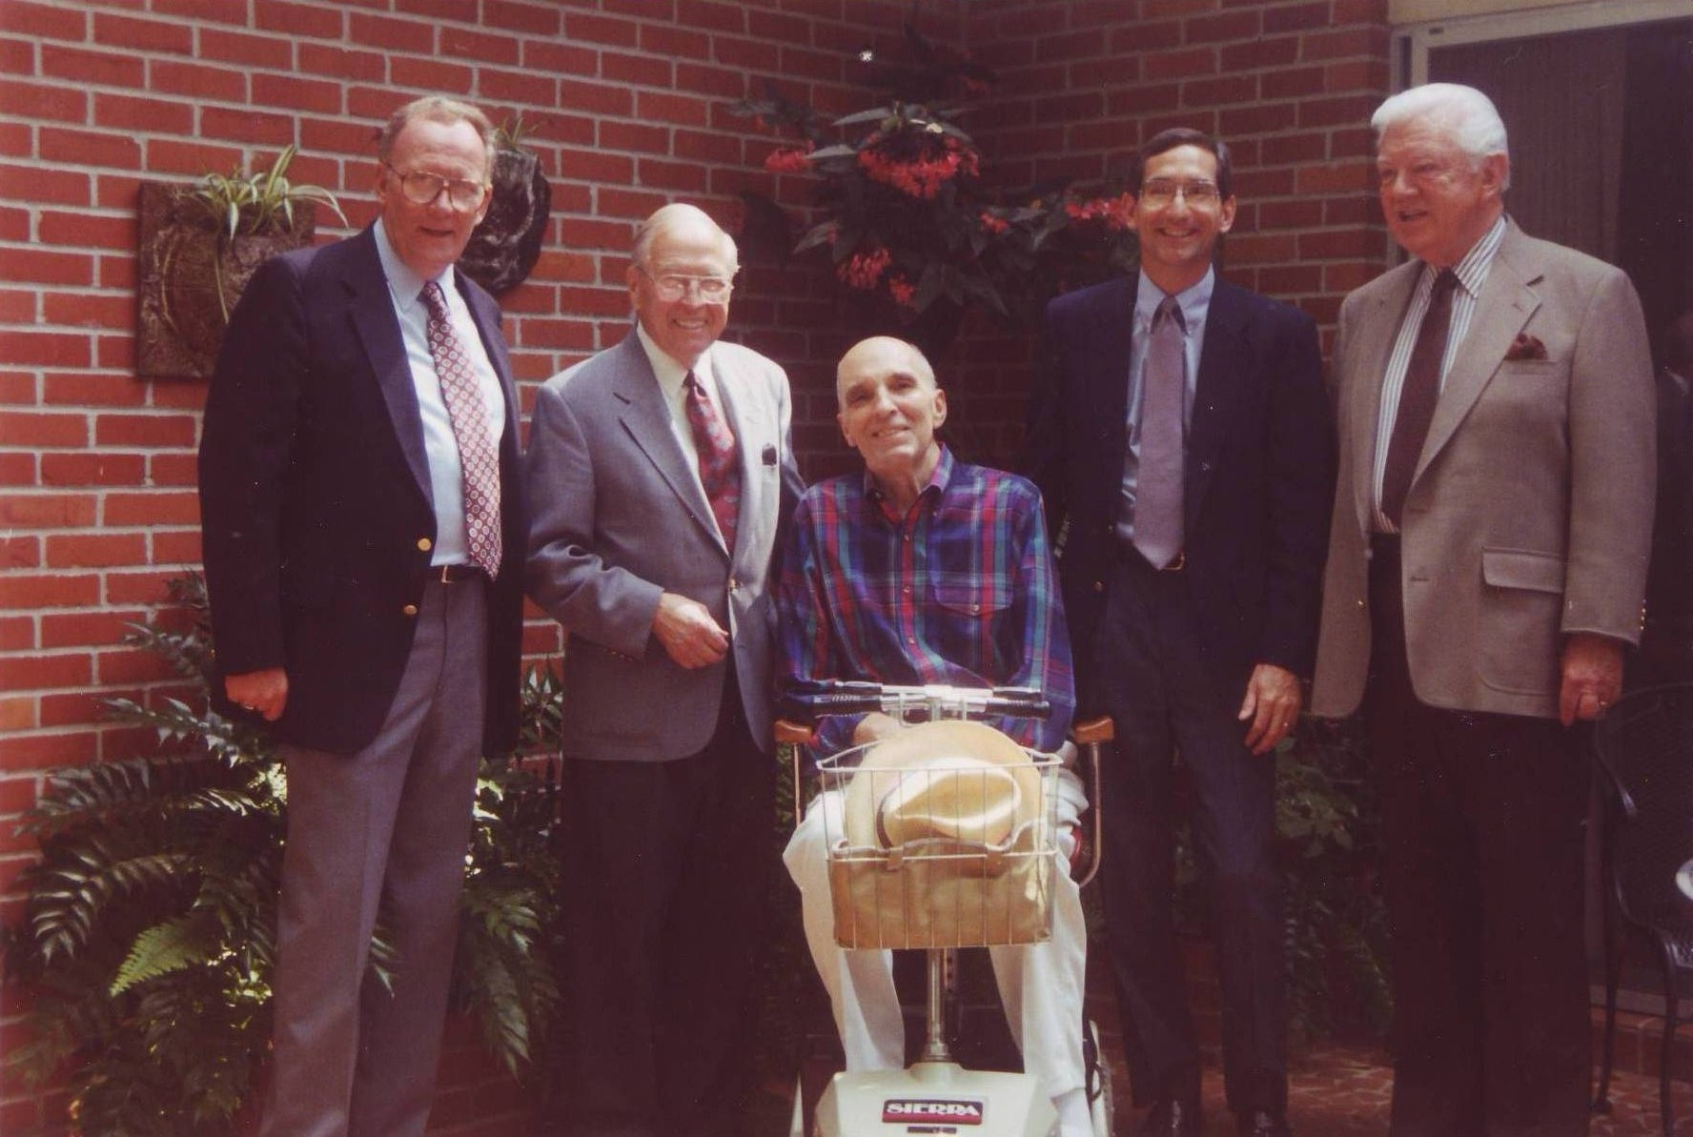
“You don’t have to be tall to be a GIANT person”
Past chairs of the Department of Communication, Sciences, and Disorders at the University of Florida. L to R is Dr. Brown, Dr. Moore, Dr. Jensen (in scooter), Dr. Gerhardt, and Dr. Abbott

Slide 9
References
G. Paul Moore. (2008, March 4). A S H A Leader, 13 (3), 38. Retrieved from http://go.galegroup.com.lp.hscl.ufl.edu/ps/i.do?id=GALE%7CA176590254&v=2.1&u=gain40375&it=r&p=HRCA&sw=w
Shafer, D. N. (2007, November 6). Two centuries of excellence. A S H A Leader, 12 (15), 44. Retrieved from http://go.galegroup.com.lp.hscl.ufl.edu/ps/i.do?id=GALE%7CA171440659&v=2.1&u=gain40375&it=r&p=HRCA&sw=w
Brown, W.S., Jr., Hicks, D.M., & Murray, T. (2008, May). In Memoriam: G. Paul Moore, Ph.D. Journal of Voice, 22 (3), 257. Retrieved from http://www.sciencedirect.com/science/article/pii/S0892199708000520

Slide 10
The 36th Annual G. Paul Moore Symposium: February 6th and 7th 2014
http://slhs.phhp.ufl.edu/moore-symposium/
Notes:
10

Slide 11
Symposium Info
NSSLHA members are required to attend at least one morning or afternoon session of the symposium, either day!
There will be a sign in/sign out sheet on both days of the event - this is how you will get your symposium point for participating
All CSD classes will be cancelled and many will require you to attend during their class hour
If you have a conflict attending for your point because of other classes, work, etc. please contact Jessica to work something out
Notes:
11

Slide 12
More Symposium Info
In addition to the Symposium point, this event is a great way to earn up to 2 service points for volunteering for shifts to help out during the event!
A google doc has been sent via email and another one will be sent out tonight. Jessica will also post it to the fb group after the meeting
https://docs.google.com/spreadsheet/ccc?key=0AjL1P3S1dFCgdF9nZ3JrWXVCVzNhaWpmNFltdlYtUHc&usp=drive_web#gid=0
Attire: Business casual
Please feel free to ask me any questions you have, and direct volunteering/points questions to Jessica! jlatassa@ufl.edu
Notes:
12

